Slide 1


Classification Prediction Analysis Customers Churn
Dana Drouskin | Hoffit Hirschsohn | Heli Alster

Slide 2

What is Churn?
Churn Rate = Percentage of customers that cancel a product or service within a given period.
Analyzing and predicting customers churn helps the company to understand customers pain points and develop a customer retention plan accordingly to try and prevent customers loss.
The object of this project is to analyze customers attributes available and predict if a customer will churn or not.

Slide 3
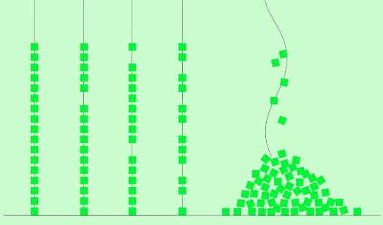
Problem Definition
What are key indicators of customers' churn?
01
What is the likelihood of an active customer to churn?
02

Slide 4
Workflow
Dataset
Data Cleaning
EDA
Pre-processing
Modeling
Hyper-parameter Tuning
Final Model
Classification:
>>|Churn
>>|No Churn

Slide 5
Data View
7043 rows & 21 columns
Dependent Target Variable: Churn
Independent Variables:
17 Categorical & 3 Continuous data types
Demographic info
Gender
Senior Citizen
Partner
Dependent
Services info
Phone Service
Multiple Lines
Internet Service
Online Security
Online Backup
Device Protection
Tech Support
Streaming TV
Streaming Movies
Account info
Tenure
Contract
Paperless Billing
Payment Method
Monthly Charges
Total Charges

Slide 6





Data Cleaning
Renamed columns to lower case letters
Dropped CustomerID column
Total Charges converted to numerical data type (spaces replaced with NaN)
NaN dropped (11 rows)
Substring '(automatic)’ removed from the Payment Method classes

Slide 7
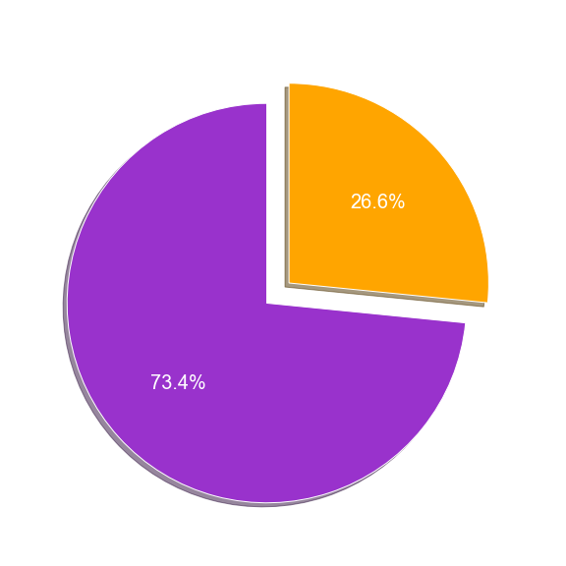
EDA Target Variable - Churn
Churn class distribution is imbalanced between churners and non-churners.
>> when modeling, we’ll ‘stratify’ the train-test split to enforce the same proportions of examples per each of the target variable classes.

Slide 8
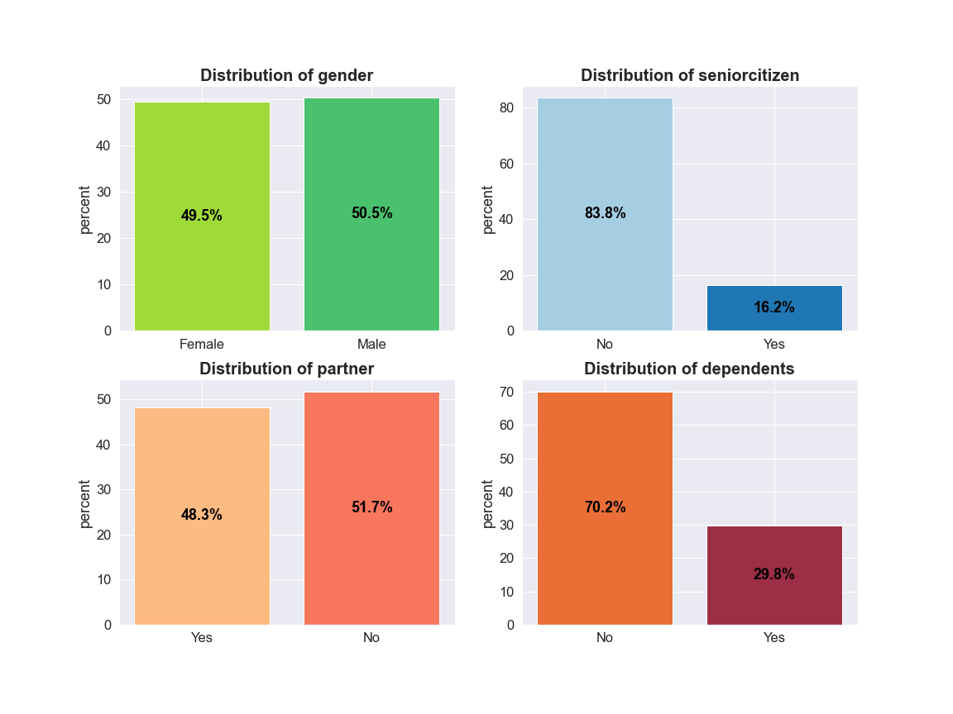
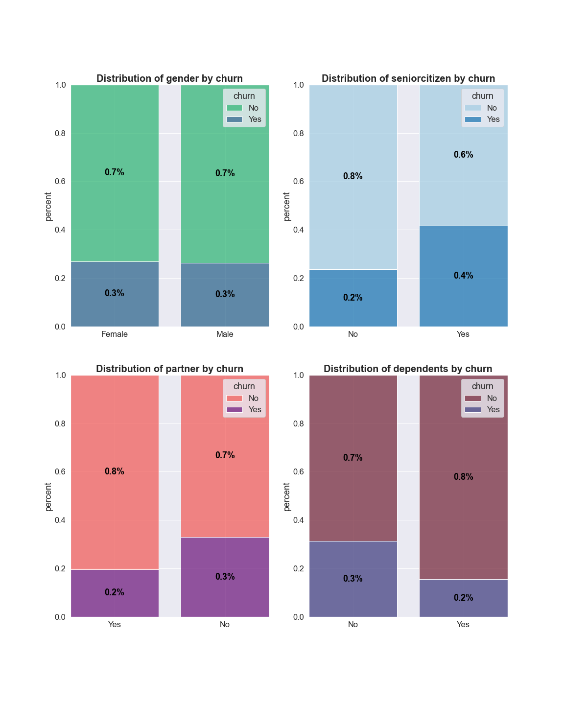
EDA – Demographical Categorical Features Distribution
Gender - there is a similar proportion of men and women, and almost no difference in the rate of churn between the genders.
Age - most of the customers are non-seniors. Senior citizens churn almost double than non senior citizens.
Familial Status - almost half of the customers have a partner, but only about a third of the customers have dependents. Customers with a partner churn less than single customers, customers with dependents churn less than customers without dependents.

Slide 9
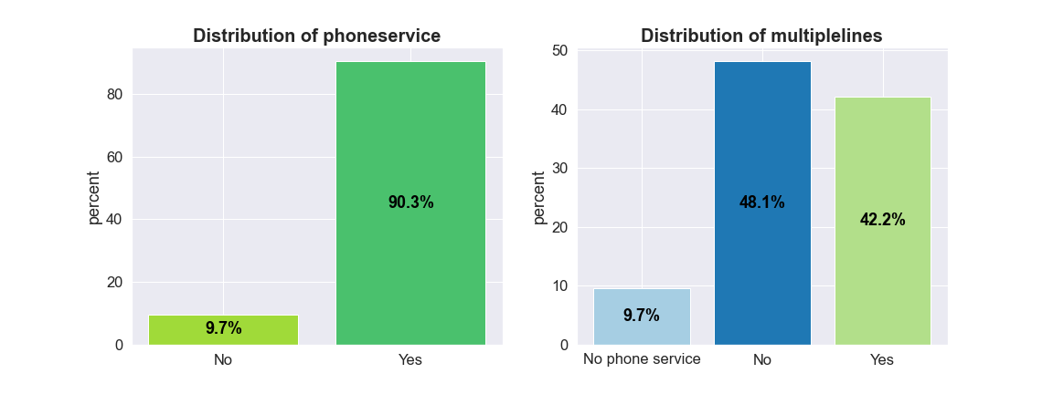
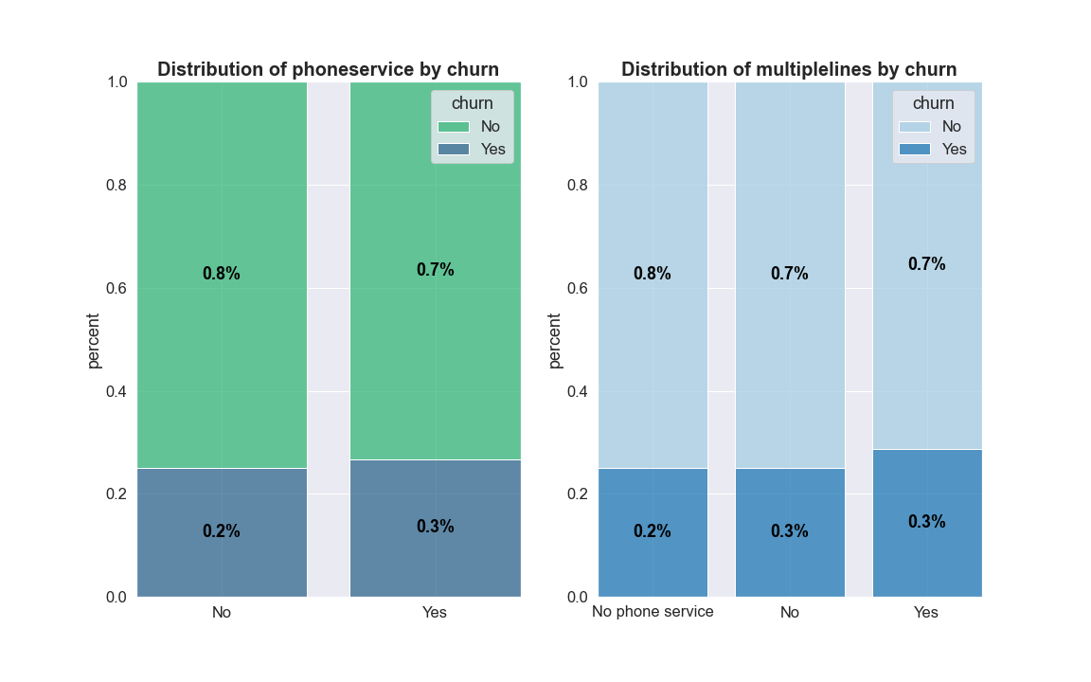
EDA – Phone Services Categorical Features Distribution
Phone Service - Most of the customers have opted for a phone services. Both customers who opted to have or not to have phone services have similar churn percentages.
Multiple Lines - Almost half of the customers with phone service opted to have multiple lines. Customers with or without multiple lines have similar churn percentages.

Slide 10
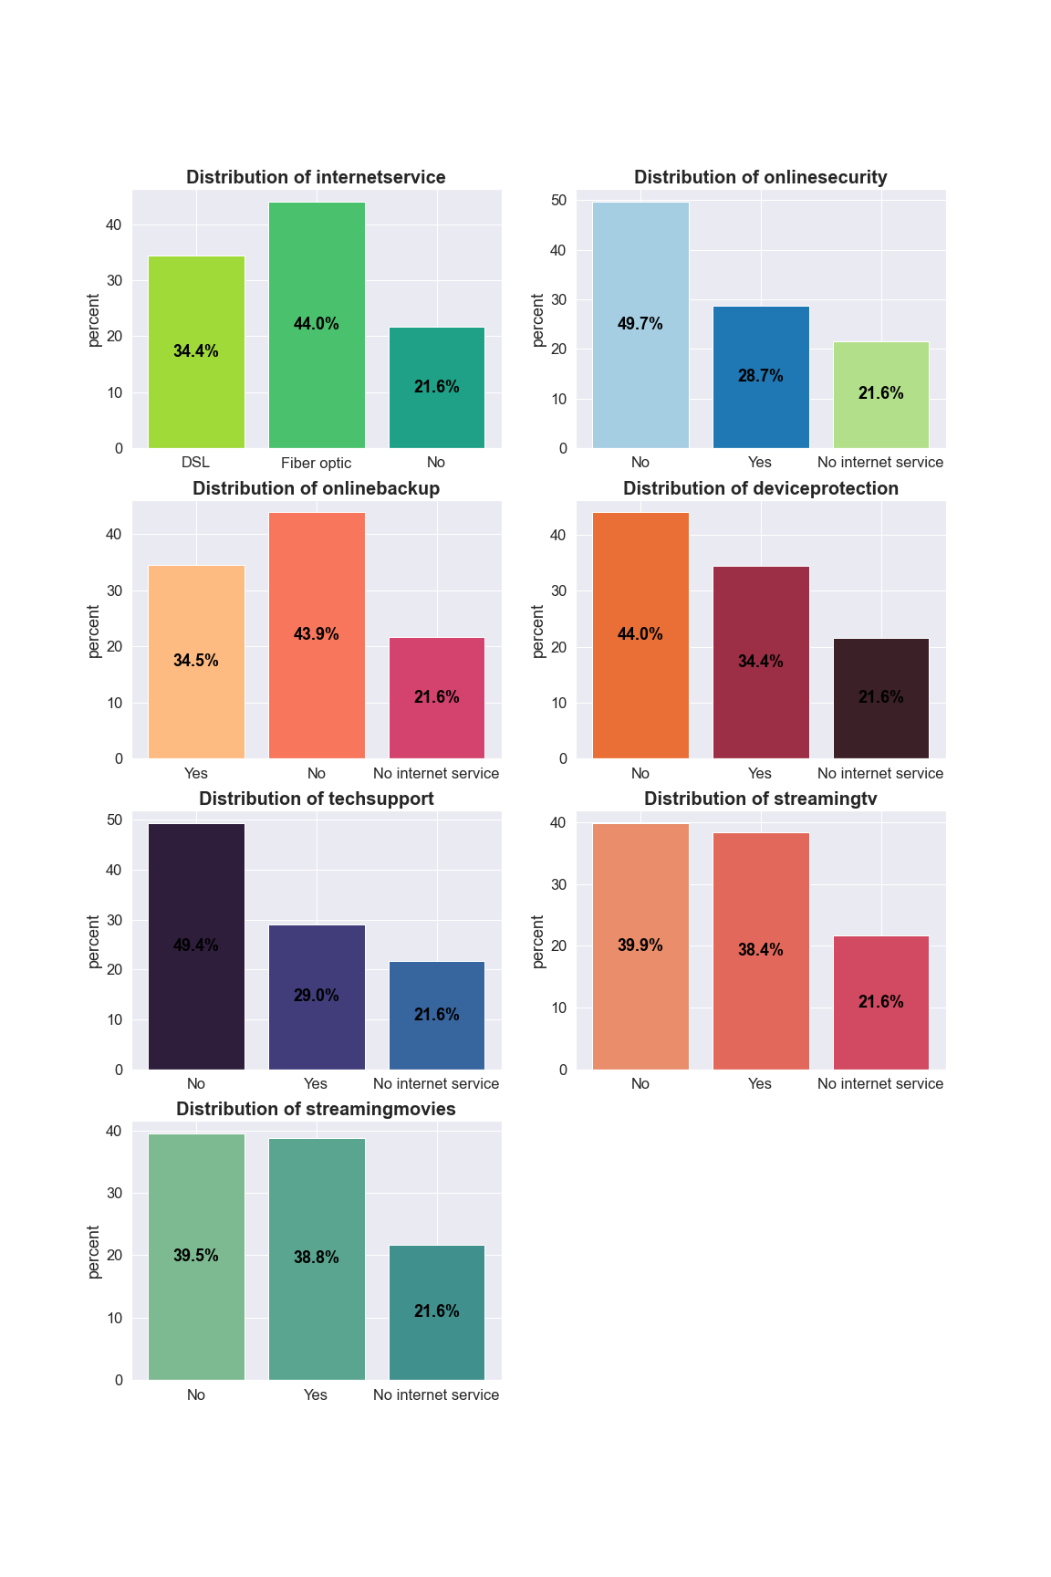
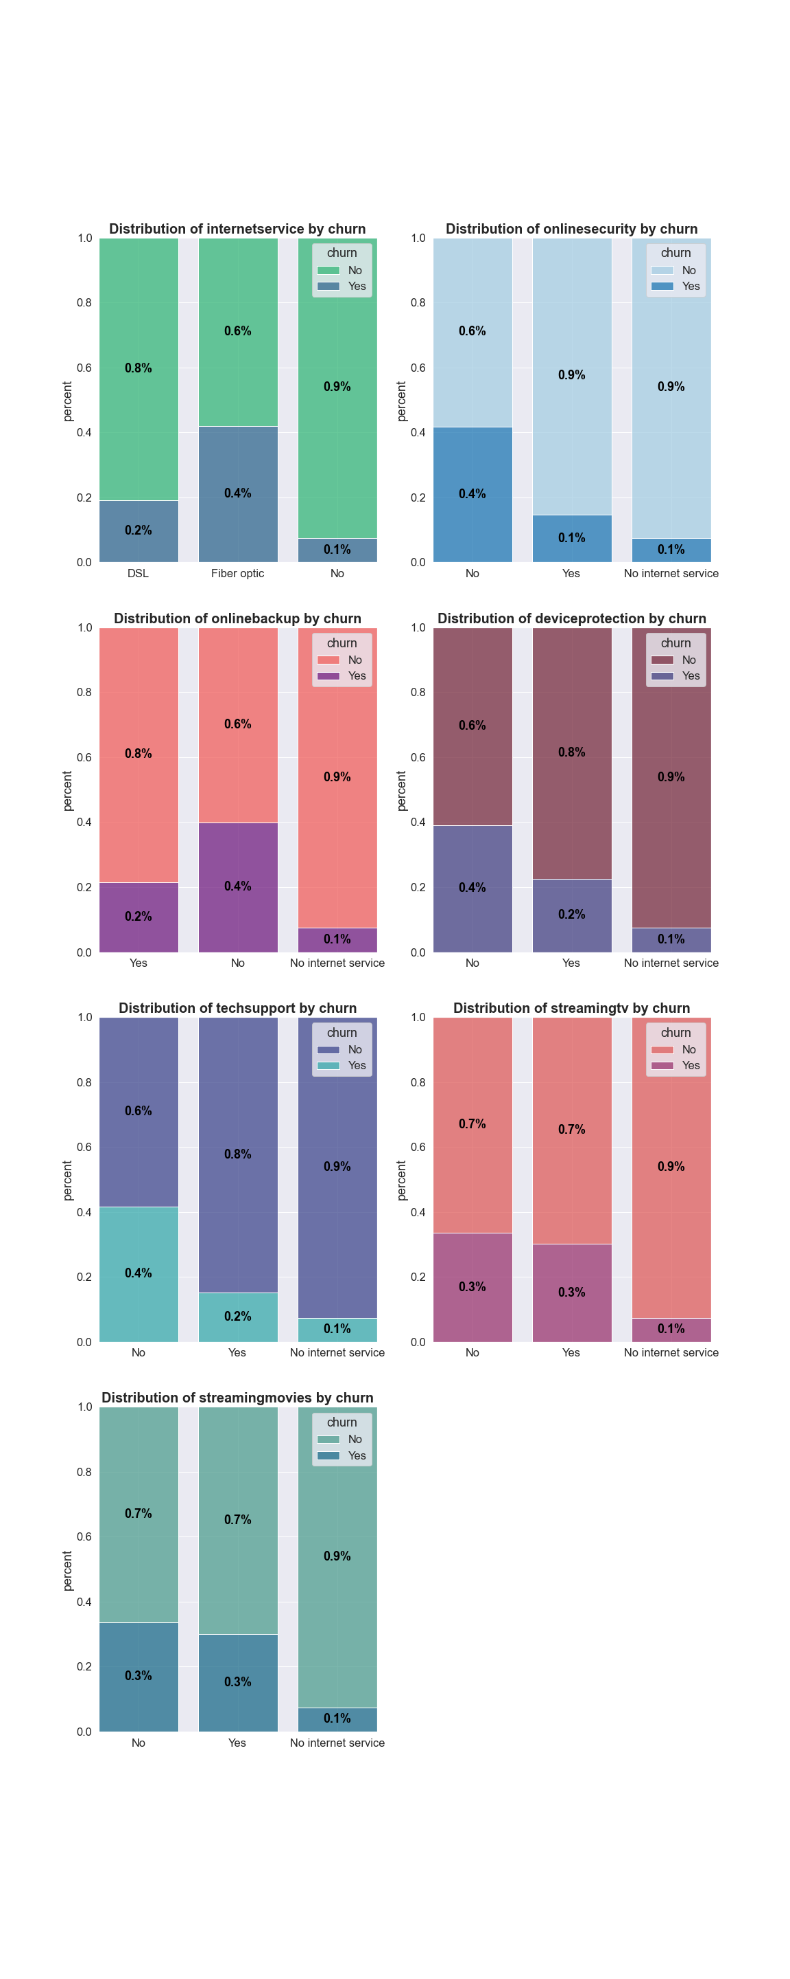
EDA – Internet Services Categorical Features Distribution
Internet Service - Almost half of the customers have Fiber Optic internet, and about 20% of the customers don't have internet at all. Customers with Fiber Optic Internet Services churn more than double than customers with DSL services. Customers with no internet services at all churn percentage is very low in comparison to customers with internet service.
Additional Services - Of the customers who have opted to have internet, almost half haven't opted for additional services. These customers churn much more than those who have opted for these services.
Streaming Services – Almost 40% of the customers have opted to have streaming services. These customers churn more than customers without streaming services.

Slide 11
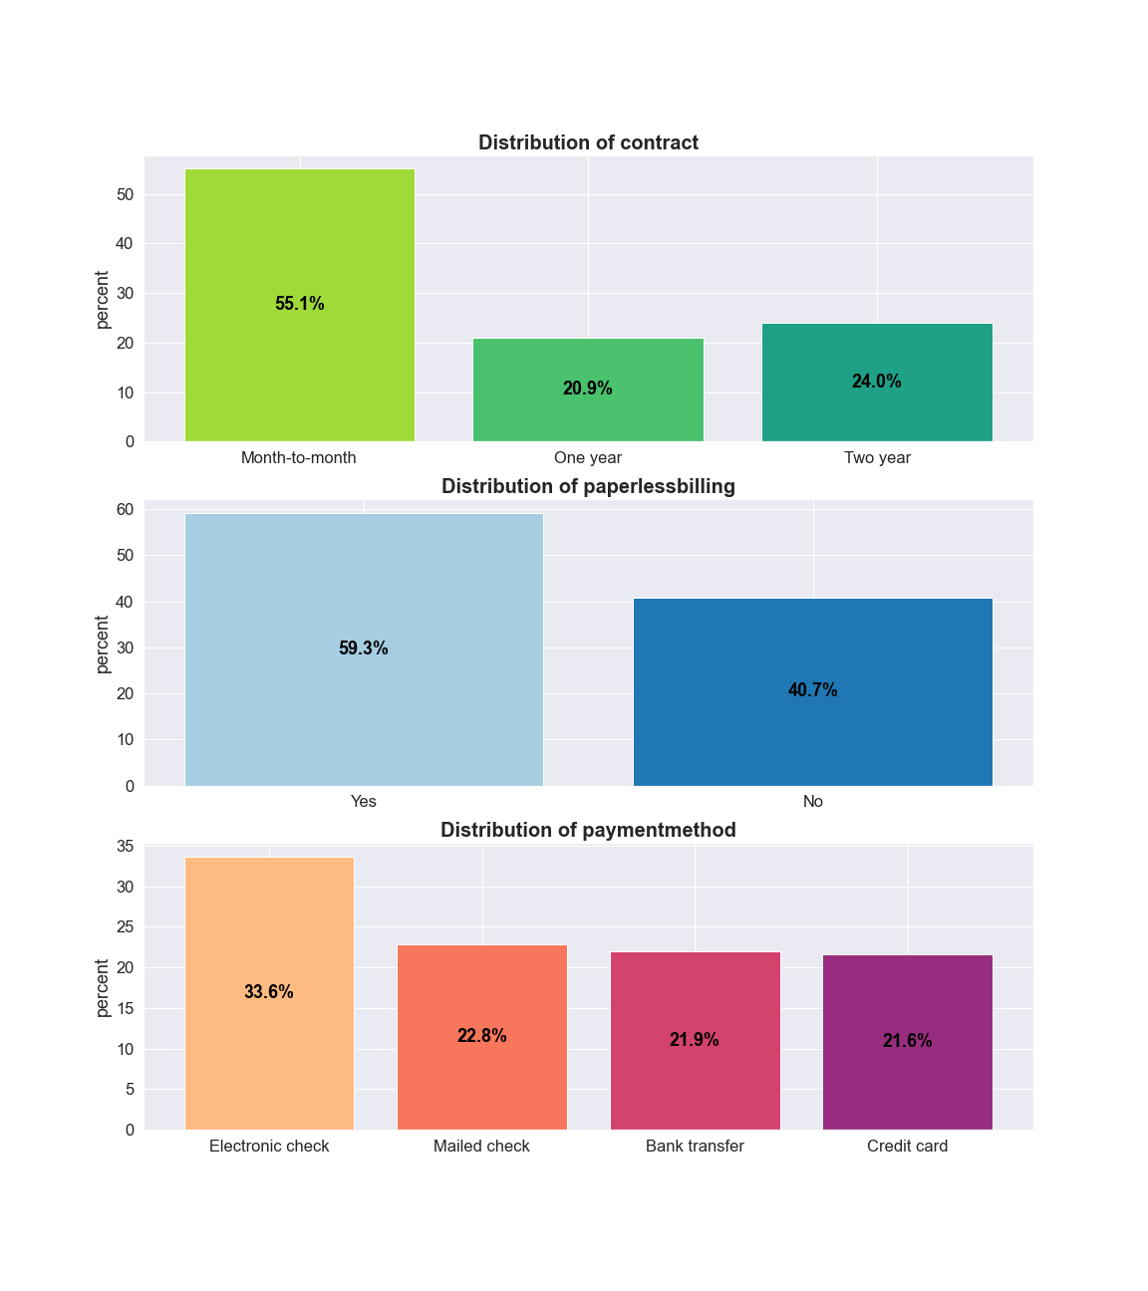
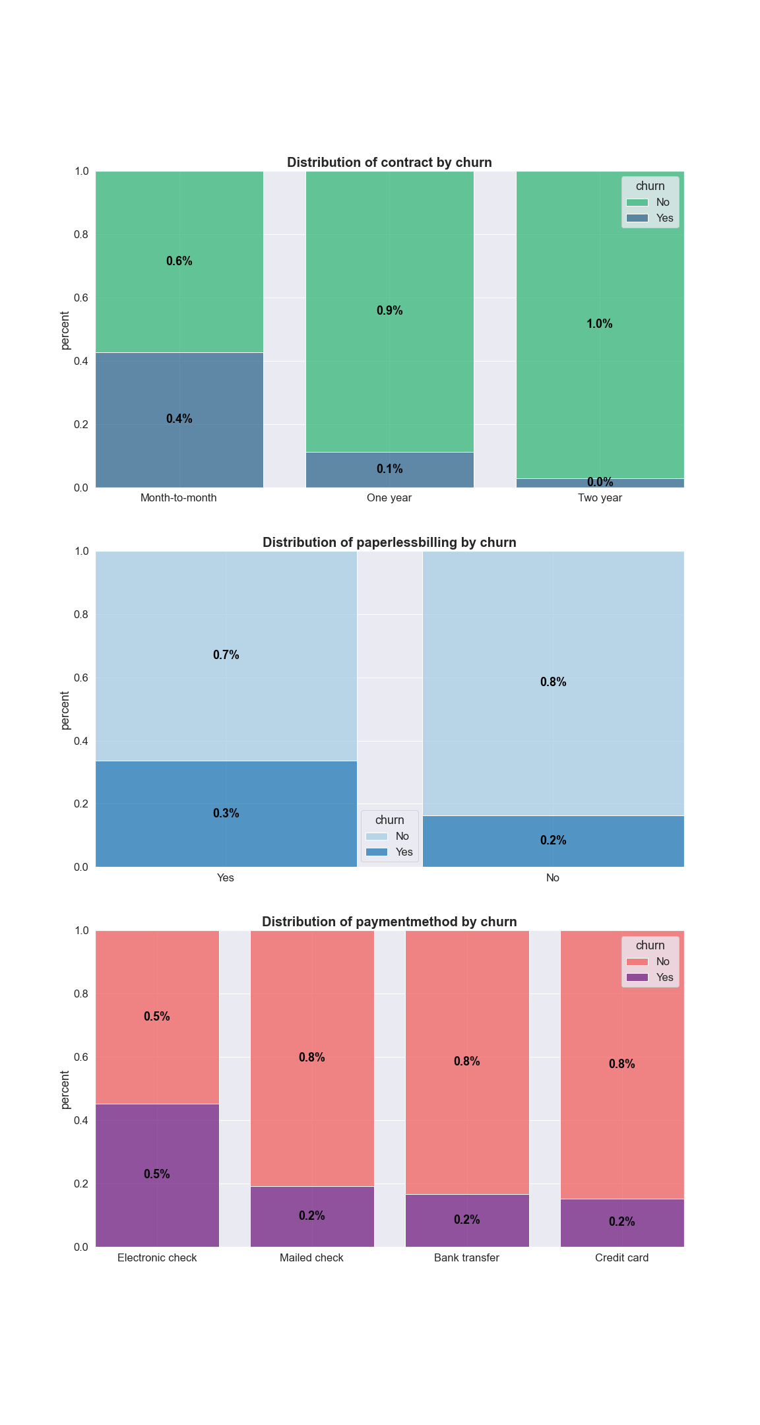
EDA – Account Categorical Features Distribution
Contract - more than half of the customers are on a monthly contract. Customers with monthly contracts churn much more than customers with yearly or bi-yearly contracts.
Paperless Billing - more than half of the customers subscribed for paperless billing. Customers subscribed to paperless billing churn much more than those who are not subscribed.
Payment Method - almost 30% of the customers pay via Electronic Check. Customers who opted for Electronic Check as a payment method are more likely to churn.

Slide 12
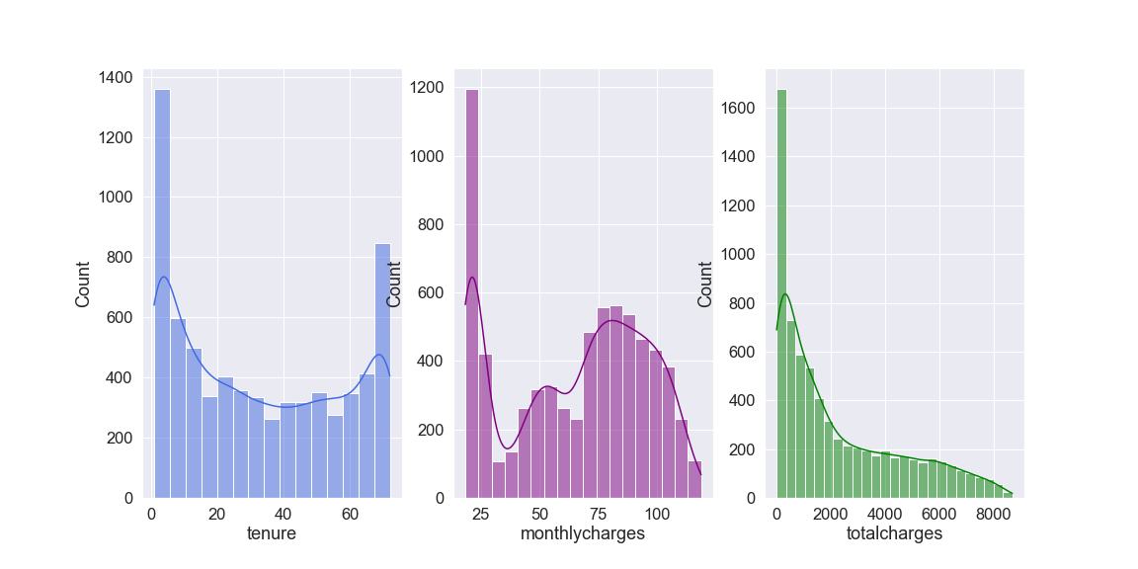
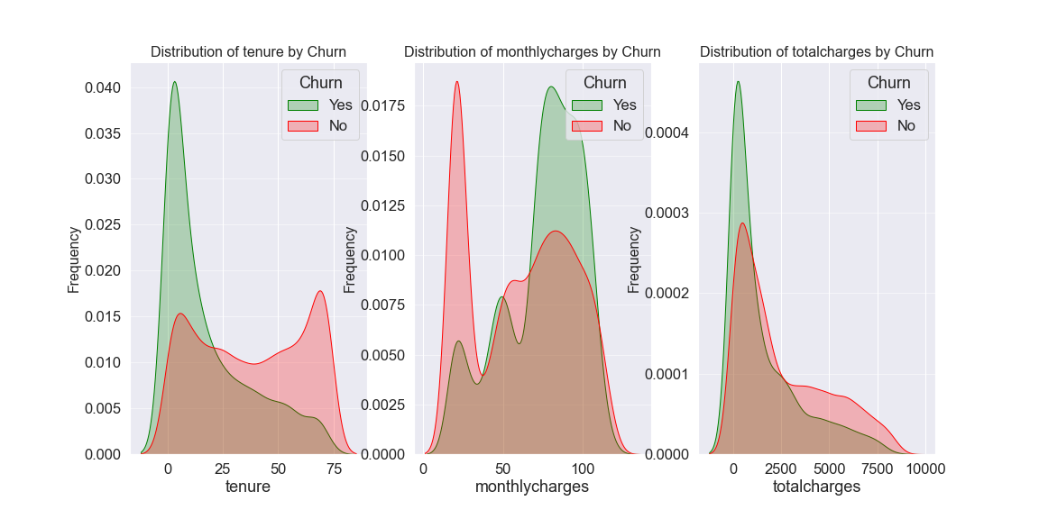
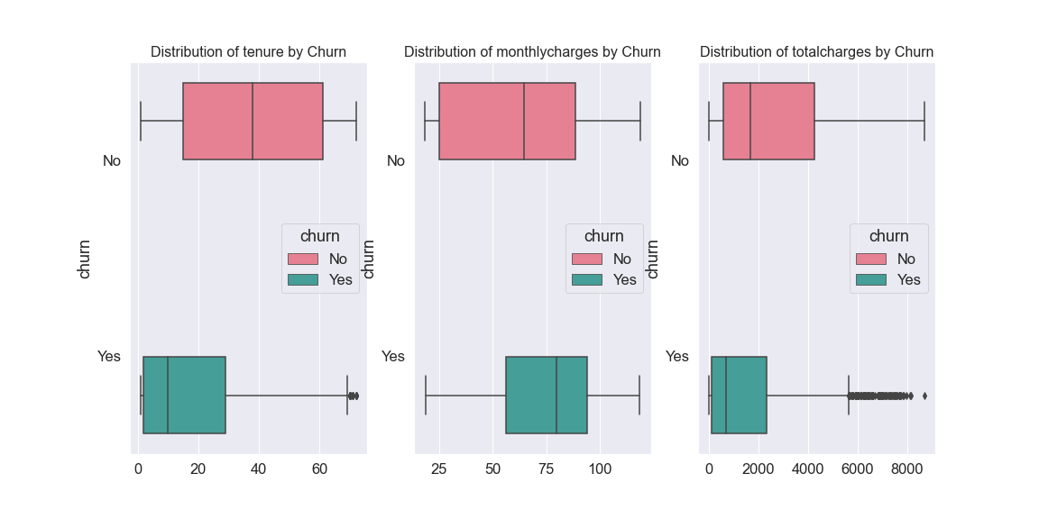
EDA – Continuous Numerical Features Distribution
Tenure - there are a lot of customers with less than 10 months of tenure, and another significant loyal customers segment with 60-70 months tenure.
New customers are more likely to churn.
Churners avg tenure is at 18 months vs non-churners at 38 months.
Monthly Charges – there are many customers paying lower rates (<$25). Churn tends to be higher with higher monthly charges. On avg, churners pay $61 per month vs non-churners who pay $74 monthly.
Total Charges - customers with higher total charges are less likely to churn.
>> possible explanation: higher monthly charge leads to high churn at lower tenure, which is presented with higher churn at lower total charges.

Slide 13






Feature Engineering
Mapped categorical binary features into numeric binary variables
Encoded non-binary categorical features into dummy variables (One-Hot-Encoding)
Created a new feature - number of additional internet-based services a customer opted to have (between 0-6)
Created a new feature - whether a customer pays above or below avg monthlycharges per contract class
Created a new feature - whether a customer opted for a bundle package (phone+internet), phone only or internet only
Click to view the code

Slide 14
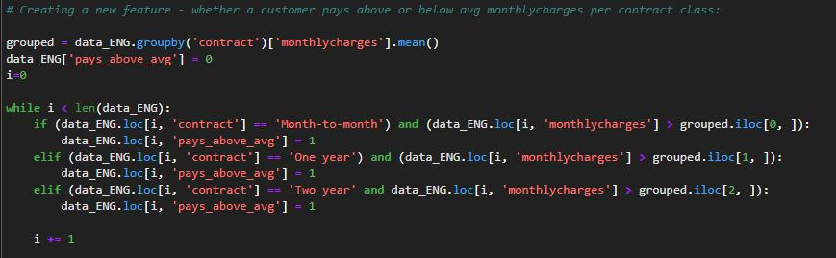
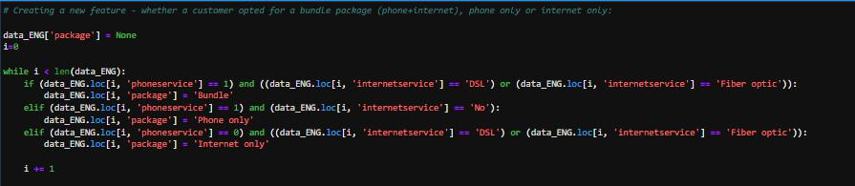
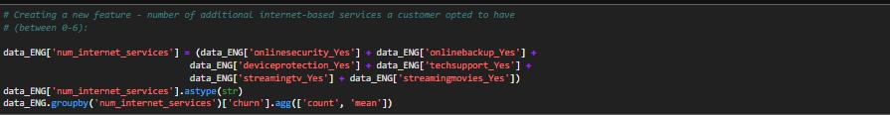
Feature engineering for new features:

Slide 15
Modeling
Data Split
Feature Selection
Setting Baseline
Algorithms
Validation
Train - 90%
Test – 10%
Pearson Correlation
Dummy classifier
Prediction per majority class – 73.4% accuracy
Random Forest (tested max_depth values 2-15 & n_estimators values 11-150 in steps of 5)
KNN (tested n_neighbors odd values 1-25)
Accuracy score
Execution time
Decision Tree (tested max_depth values 2-14)
(split is stratified per data imbalance)

Slide 16
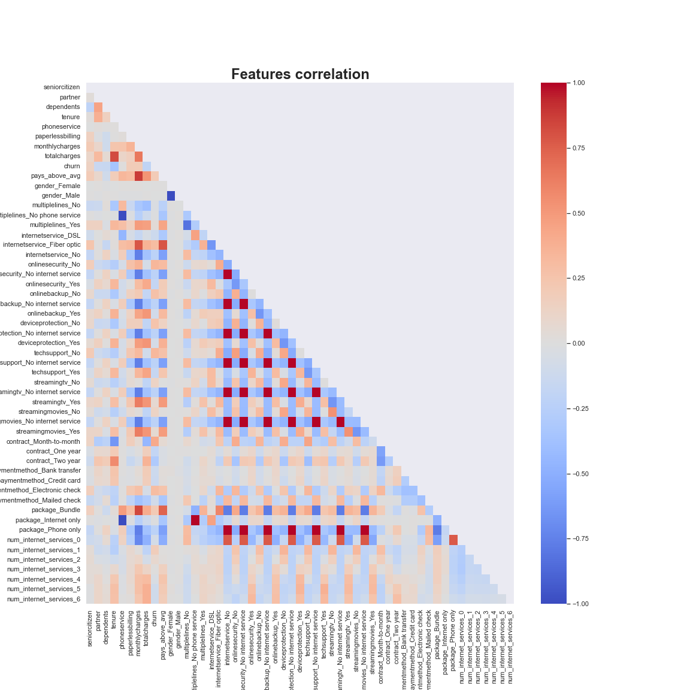
Variables Correlation
Strong correlation between:
phoneservice and multiple lines
Internet service and related additional internet-based services.
Internet-based services themselves.

Slide 17
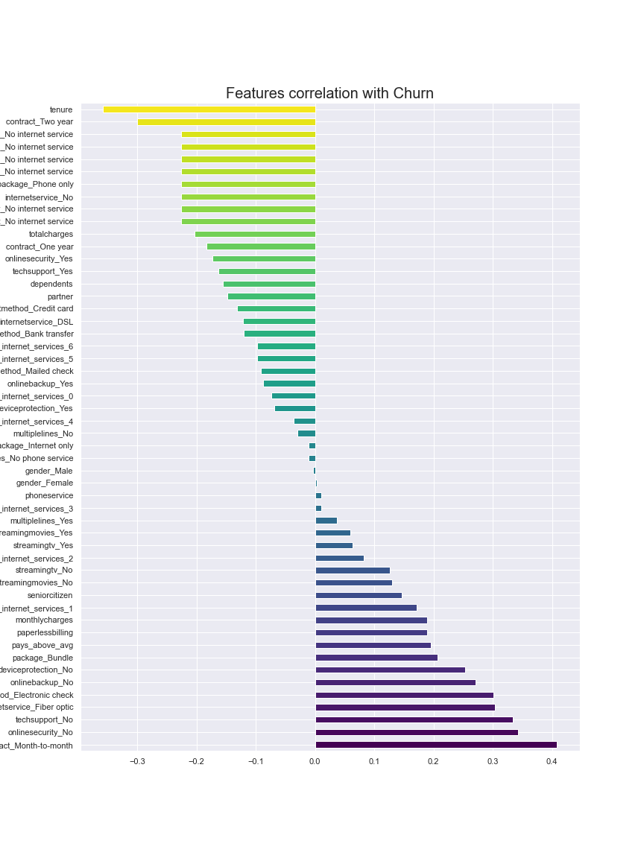
Variables Correlation with Churn
There is a strong positive correlation between monthly contracts and churn – this is logical:
no longstanding contracts allow for easy attrition
There is a strong negative correlation between tenure and churn – this is logical:
longer tenure >> higher loyalty >> less churn
Areas of positive correlation with churn that need more exploring:
Fiber optic internet
Electronic check payment method
Paperless billing
Senior citizens

Slide 18

Features Selection
We defined a function to find all variables that have a Pearson correlation coefficient of more than 0.9 based on data presented in the train split. Each pair of variables that applies to the above rule was compared against its correlation with churn in order to remove the variable with lower influence on churn from both the train and test splits.
Features removed:
'deviceprotection_No internet service'
'gender_Male’
'internetservice_No'
'multiplelines_No phone service'
'onlinebackup_No internet service'
'onlinesecurity_No internet service'
'package_Internet only'
'streamingmovies_No internet service'
'streamingtv_No internet service'
'techsupport_No internet service'
To view the function, click here

Slide 19
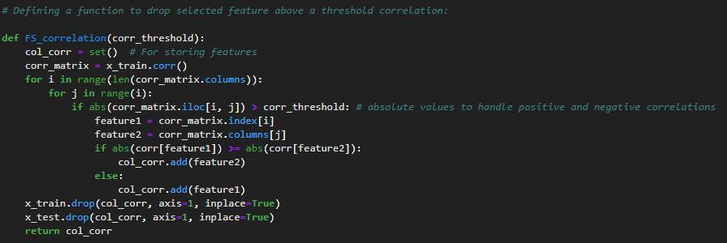
Function to choose which features to remove from the model based on a given correlation coefficient threshold:
We are calculating correlation on x_train set only, to avoid data leakage from the test set that will influence the algorithm training

Slide 20
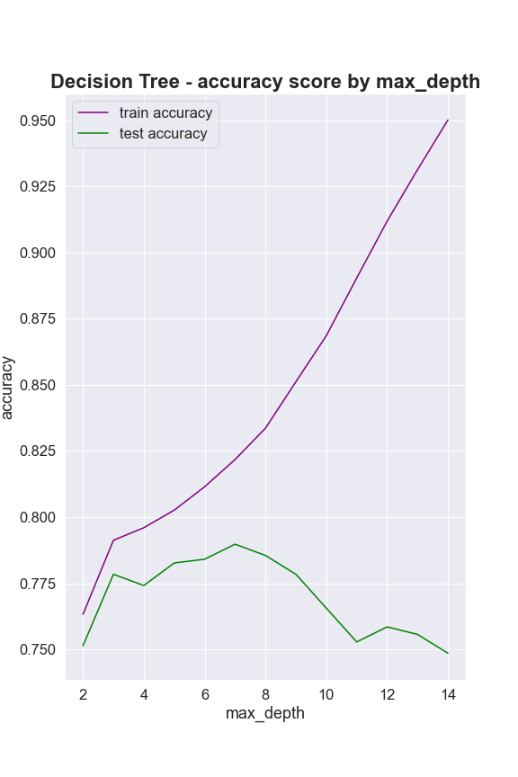
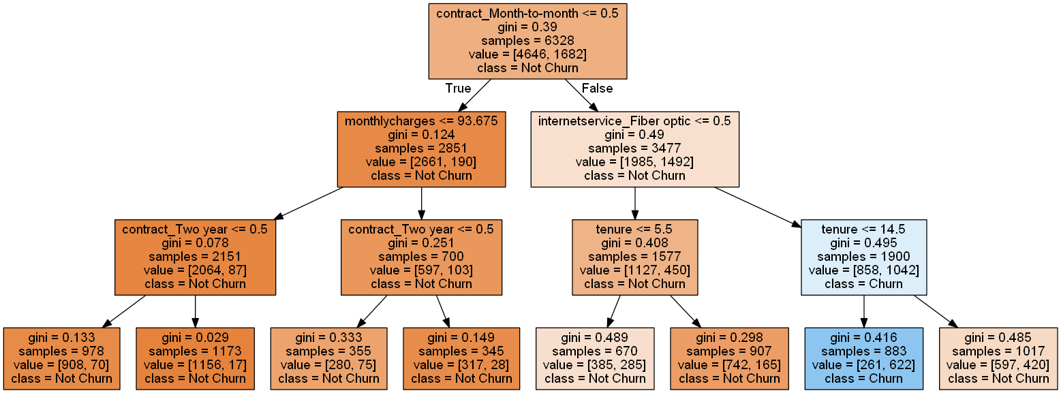
Decision Tree
We tested the Decision Tree Classifier for different max_depth values ranging from 2 to 14.
Optimized accuracy score is 79.1% per max_depth=7.
Decision Tree per max_depth = 3:

Slide 21
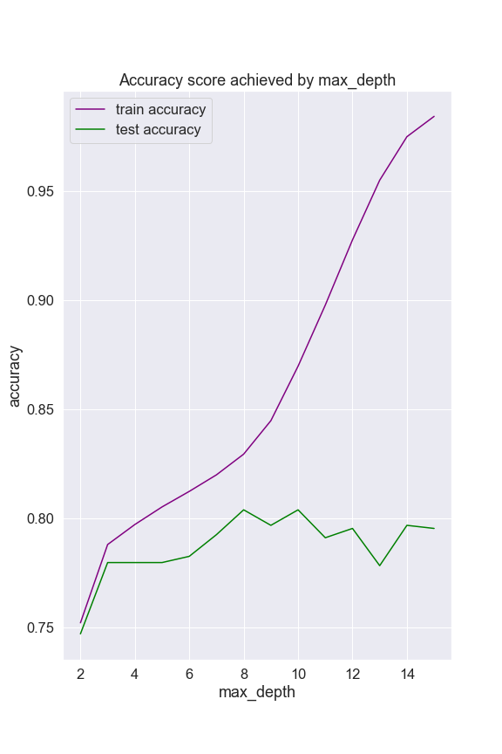
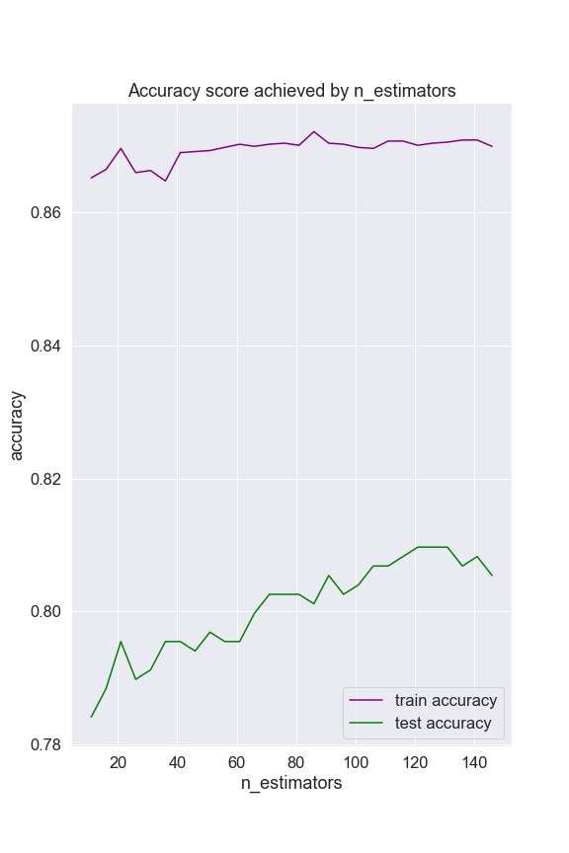
Random Forest
We tested the Random Forest Classifier for different max_depth values ranging from 2 to 15, and different n_estimators ranging from 11 to 150.
Optimized accuracy score is 81% per max_depth=10 and n_estimators=131 .

Slide 22
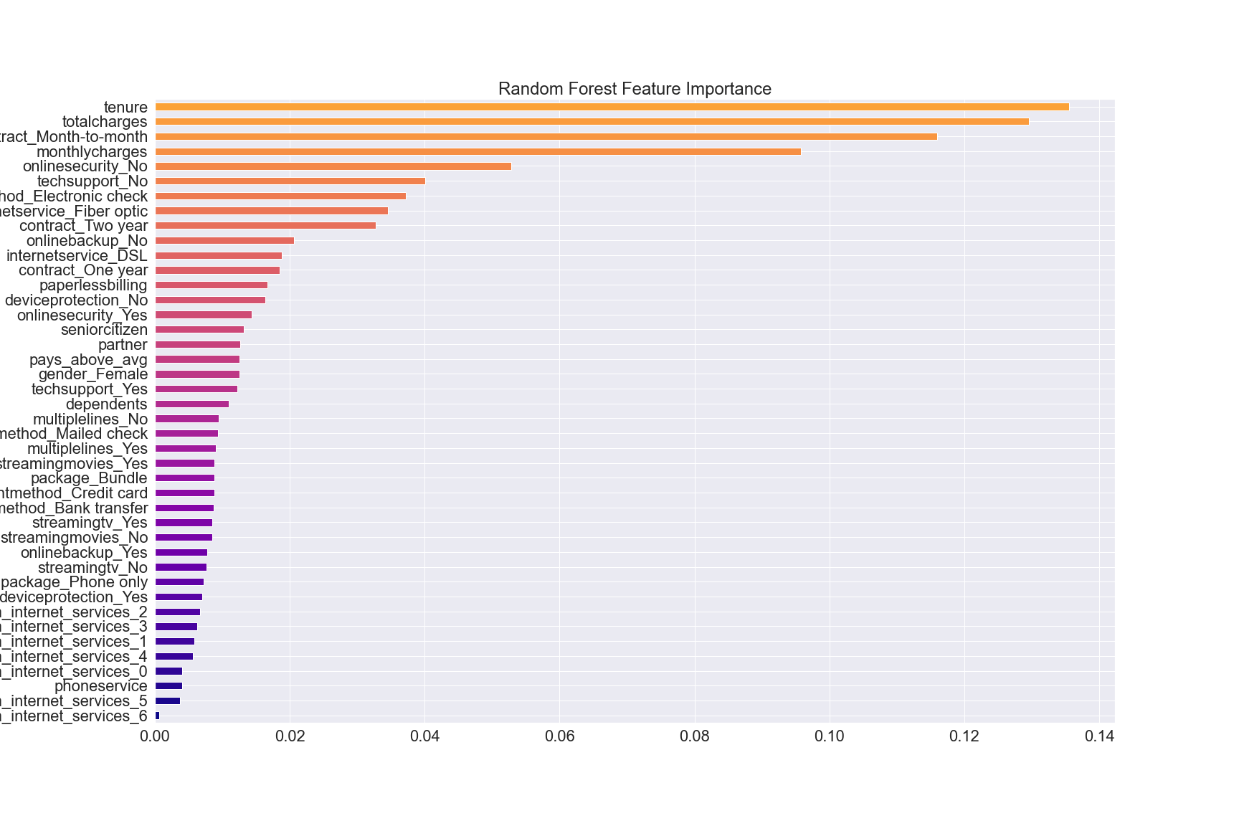
Random Forest – Feature Importance

Slide 23
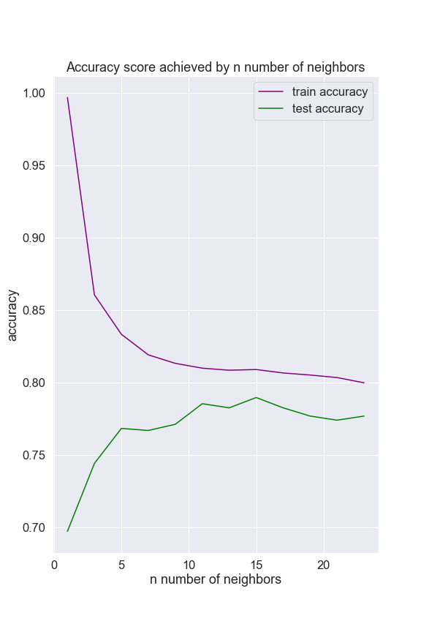

K - Nearest Neighbors
First, we scaled x_train data to standardize numeric variables.
We tested the KNN Classifier for different odd n_neighbors values ranging from 1 to 25.
Optimized accuracy score is 75.9% per n_neighbors=15.

Slide 24

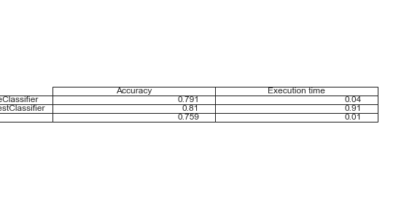
Results
All models performed better than the baseline model (74.4%) considering accuracy score.
Random Forest outperformed all models as far as accuracy score of 81%, although it is the slowest algorithm.
Chosen Model:
Random Forest
Max_depth = 10
N_estimators = 131

Slide 25


Conclusions
01
Within the scope of this project, Random Forest algorithm will provide the highest accuracy rate of 81%, however, it is considerably slow in comparison with the other algorithms. Therefore, for a bigger dataset, the Decision Tree algorithm should be taken into consideration.
02
Key areas to take forward in order to reduce churn:
Service
Marketing
Enhance tech support
Improve Fiber optic
Direct customers to simple payment methods
Aim to move customers to long-term contracts
Attempt to upgrade customers to online services

